Slide 1
Car Price Prediction
Project report and spets

Slide 2
Problem Statement:
With the covid 19 impact in the market, we have seen lot of changes in the car market. Now some cars are in demand hence making them costly and some are not in demand hence cheaper. One of our clients works with small traders, who sell used cars. With the change in market due to covid 19 impact, our client is facing problems with their previous car price valuation machine learning models. So, they are looking for new machine learning models from new data. We have to make car price valuation model. This project contains two phaseData Collection Phase You have to scrape at least 5000 used cars data. You can scrape more data as well, it’s up to you. more the data better the model In this section You need to scrape the data of used cars from websites (Olx, cardekho, Cars24 etc.) You need web scraping for this. You have to fetch data for different locations. The number of columns for data doesn’t have limit, it’s up to you and your creativity. Generally, these columns are Brand, model, variant, manufacturing year, driven kilometers, fuel, number of owners, location and at last target variable Price of the car. This data is to give you a hint about important variables in used car model. You can make changes to it, you can add or you can remove some columns, it completely depends on the website from which you are fetching the data. Try to include all types of cars in your data for example- SUV, Sedans, Coupe, minivan, Hatchback

Slide 3
Projects steps
Loading data
Data Exploration
Features with Null value
Numerical Features
Do EDA for analysing data Properly
Data Cleaning
Remove some unrelated features
visualize Data
Data transformation
Base Model Performance (Random Forest)
Hyperparameter Tuning
Final Model
Visualize Results

Slide 4
Details
There are 6019 entries in the train data set. The data contains some NaN values too.
Lets check for NaN (null) values in the data
we check the percentage of nan values present in each feature
We might want to remove columns with more than 50% missing values
We check the correlation with the features.
We created some new columns.
We remove some extra data from the existed columns.
We make changes in type of some feature from object to numerical like(int and float).

Slide 5
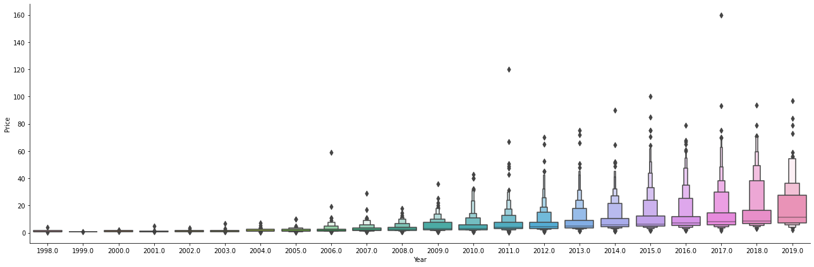
EDA part
Create catplot between Price and year.

Slide 6
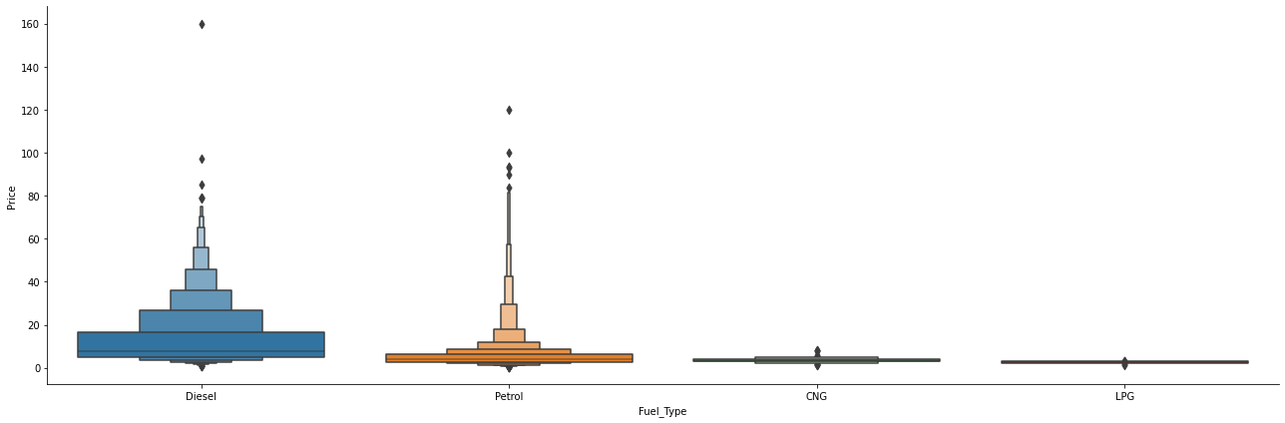
EDA part
Create catplot between Price and Fuel_type.

Slide 7
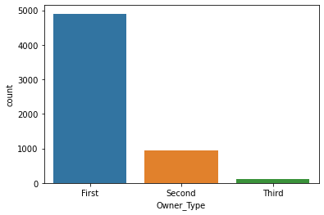
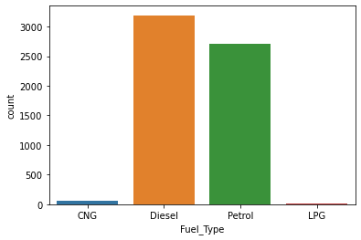
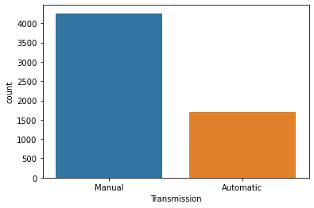
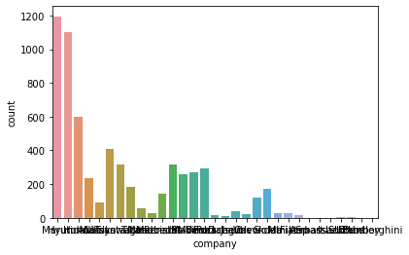
EDA Part
Create some count plot for analysis the numbers.

Slide 8
EDA Part
We encode the object data type feature with LabelEncoder.
We create some distplot for check the distribution.
We make separation in dependent feature and independent feature.
Create x with independent features and y with dependent feature.
Firstly we fit ExtraTreesRegressor for find the importance of feature of dataset.
We see that some feature are less important for dataset so drop that which importance are less then 1.0.
We Standardice the X’s feature for better result.
We split the data in train and test dataset for fir more models.

Slide 9
Details
We see that the target feature are in continous form that’s way we apply linear and regressor models.
Here we apply four models.
LinearRegression()
XGBRegressor()
RandomForestRegressor()
DecisionTreeRegressor()

Slide 10
Details
We fit all the models with x_train and y_train data.
We find the score of all models and we find that RandomForestRegressor gave the best result.
We find R2_score with the datasets .
We Find Mean square error and Square root of mean square error.
We create the dist plot with the difference of y_test and Y_pred data for all the models.
We did hyperperameter tuining with RandomizedSearchCV for increase the score’s of models.
We got a slight improvement with hyperparameter tuning
Finaly we find that the DecisionTreeRegressor is the best fit model for our dataset.
We save are model with RandomForestRegressor.

Slide 11
Details
Different models I tried:
( Root Mean Squared Error before hyperperameter tunning)
LinearRegression: 6.63170815917486
XGBRegressor: 3.7255926585515047
RandomForestRegressor: 4.204085622333121 DecisionTreeRegressor : 6.226030461036974

Slide 12
Details
DecisionTreeRegressor, RandomForestRegressor gave the lowest RMSE so I chose these model and performed hyper parameter tuning(RandomizedSearchCV).
Finaly RandomForestRegressor gave lowest RMSE.

Slide 13
Result
Model Accuracy:
RandomForestRegressor:
MAE: 1.7920827391065353
MSE: 18.39577444842702
RMSE: 4.289029546229195

